Slide 1
ADD-ON COURSE
Development of skills for environmental sustainability
पर्यावरणीय स्थिरता अथवा संपोषणीयता के लिए कौशलों का विकास
Prof. Shakti Sharma
K.P. Training College,Prayagraj

Slide 2
A pollution-free environment is an ideal state where all forms of pollution are
minimized to levels that do not cause harm to human health or ecological
systems. It's a concept that encompasses clean air, water, and land, free from
harmful substances.
Teachers, who provide an understanding of environmental care can
help pupil teachers to develop environmentally responsible sustainable
behaviors. They can play a crucial role in cultivating ethical values, a genuine
love and care for nature in their pupil teachers. They can teach habits such as
efficient energy use, waste reduction, recycling, and water saving. That is the
reason that this add on course must be begin in B. Ed. training program.

Slide 3
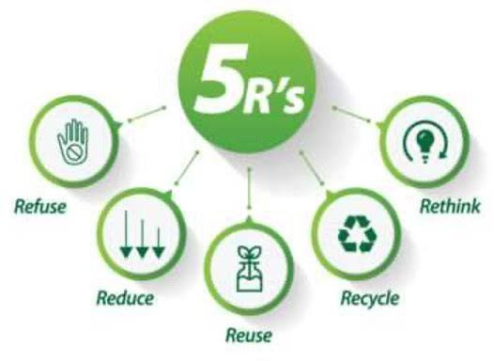

Slide 4
*To enable the pupil teachers to understand the significance of pollution free environment.
*To enable the pupil teachers to understand various human activities which are responsible for pollution.
*To enable the pupil teachers to understand the effects of various pollution on our health.
* To enable the pupil teachers to take various measures to make our environment pollution free.

Slide 5
After completing the course, the pupil teachers will be able to:-
• Understand the significance of pollution free environment.
• take measures to stop various activities which are responsible
for pollution.
• become conscious for their health by playing role in preventing
causes of pollution in the environment.
motivate others for maximum plantation, avoid exploitation of
natural resources, keep balance in our ecosystem and prevent
human caused natural disasters, stop deforestation etc.

Slide 6
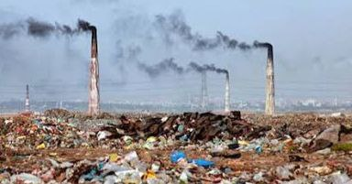
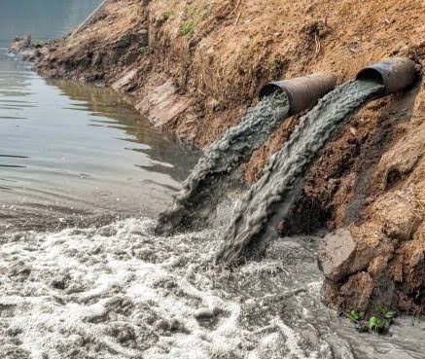
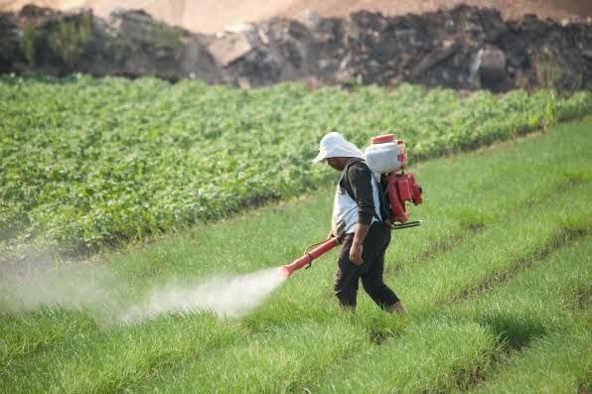
Unit 1
Meaning, Nature, Scope, Objectives And Importance Of
Environmental Education
Unit 2
Meaning And Types Of Environmental Pollution (Air Pollution, Water Pollution, Soil Pollution, Sound Pollution, Chemical`/Food pollution) And Its Effects On Human Beings

Slide 7
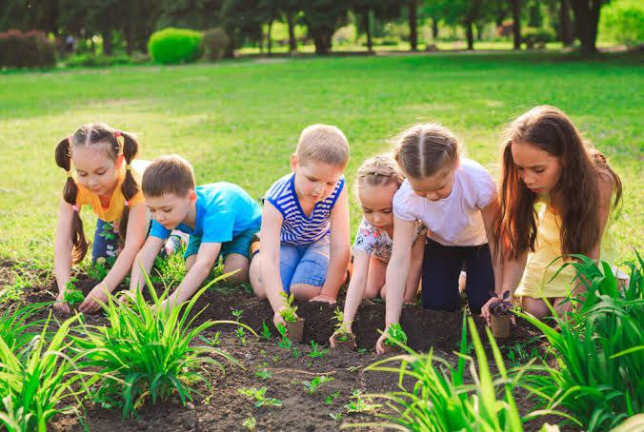
Unit 3
Environmental hazards: Climate Change, Global Warming, Greenhouse Effects, Acid Rain, Ozone Layer, Deforestation. Effects of These Hazards on environment.
Unit 4
Concept, Definition, Types And Management Of Disaster
Unit 5
Role Of School In Environmental Conservation And Sustainable Development

Slide 8
Rationale of Environmental Education
* Simple Activity For Environmental Awareness
Measures To Remove These Pollution, Message Based Various types of
activities like Skits, Essay Writing, Poetry Recitation, Slogans etc.
Would Be Accomplished By The Pupil Teachers.
*

Slide 9
* Collage/Poster Making On Such Hazards
* To Make Paper Or Cloth Bags To Say Plastic No
First Aid, Fire Fighting, Knots, Rescue Techniques.
* To Promote Natural Disaster Preparations.
* Investigate Local Environmental Issues.
To Create A Work Of Art Made Of Recycle Objects ( Cans, Jar And
Other the Recyclable Items And Write A Short Narrative
Of What They Used And How They Recycled The Materials)

Slide 10
*Dr Usha Mishra Paryavaran Shiksha
*Dr C S Shukla Paryavaran Shiksha
*Dr M K Goyal. Paryavaran Shiksha
*Dr Chandrabhushan
Pathak. Paryavaran
Shiksha AVM Prabandhan
*Dr Rajkumar Sharma Paryavaran
Sanrakshan AVN Kanoon
Website -
*https://swayam.gov.in
*Mongabay - India

Slide 11
Message based various activities like Skit, Essay writing, Poetry Recitation, Slogan etc.,
Assignment, Group Discussion Presentation, Viva
Voce, Course - end test.

Slide 12
Tentative schedule and distribution of marks
Unit | Time allotted in hours Theory | Time allotted in hours Practical | Marks Theory | Marks Practical
01 | 04 | 01
02 | 12 | 02
03 | 10 | 02
04 | 06 | 10
05 | 04 | 09
Total | 36 | 24 | 60 | 40
Grand Total | 60 | Hours | 100 | Marks

